Slide 1
Chapter 8 Section 2
Fungi

Slide 2
What are Fungi ?
Most fungi are many-celled and are found in warm, humid areas.
The body of a fungus is usually a mass of many-celled, threadlike tubes called hyphae.
The hyphae produce enzymes that help break down food outside of the fungus.
Then, the fungal cells absorb the digested food.
Saprophytes- are organisms that obtain food by absorbing dead or decaying tissues of other organisms.

Slide 3
Other Characteristics of Fungi
Fungi grow best in warm, humid areas such as tropical forests or between your toes.
You need a microscope for to see some fungi, while other fungus can grow to a substantial size.
Asexual and sexual reproduction in fungi usually involves the production of spores.
Spore- waterproof reproductive cell that can grow into a new organism

Slide 4
Types of Fungi
Club Fungi
Sac Fungi
Zygote Fungi and Other Fungi

Slide 5
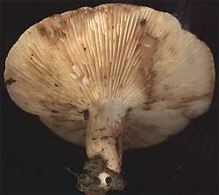
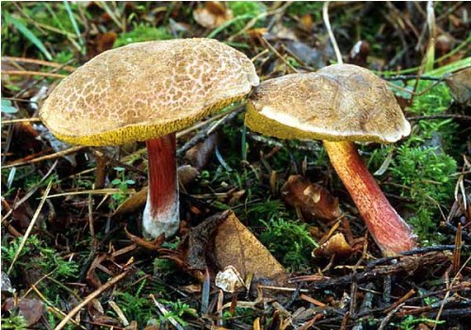
Club Fungi
-The mushrooms that you all are probably the most familiar with are the club fungi.
-Their spores are produced in a club-shaped structure called basidium.

Slide 6
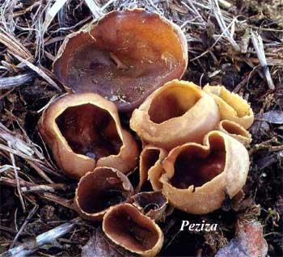
Sac Fungi
Yeasts, molds. Morels, and truffles are all examples of sac fungi.
The spores of these fungi are produced in a little, saclike structure called an ascus.
Yeasts reproduce sexually by forming spores and reproduce asexually by budding.
Budding- is a form of asexual reproduction in which a new organism forms on the side of a parent organism.
The 2 organisms are genetically identical.

Slide 7
Zygote Fungi and Other Fungi
The fuzzy black mold that you sometimes find growing on a piece of fruit or and old loaf of bread is a type of zygospore fungus.
Fungi that belong to this group produce spores in a round spore case called a sporangium.
When the sporangium splits open, hundreds of spores are released into the air and each spore will grow and reproduce if it lands in a warm, moist area that has a food supply.
Some fungi never reproduce or never have been observed reproducing because of this these fungi are difficult to classify and grouped in the “Other” category.
Penicillium is a fungus that is in the other fungi group.
The antibiotic penicillin is produced by the fungi penicillium.

Slide 8
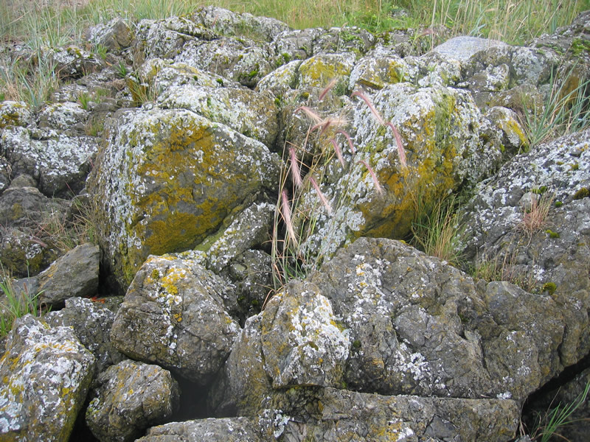
Lichens
Lichens- is an organism that is made of a fungus and either a green algae or a cyanobacterium
-The 2 organisms have a relationship in which they both benefit.
The algae or cyanobacterium lives among the threadlike stands of the fungus and the fungus gets food made by the green algae or cyanobacterium.
Lichens are an important part in the weathering process of rocks.

Slide 9
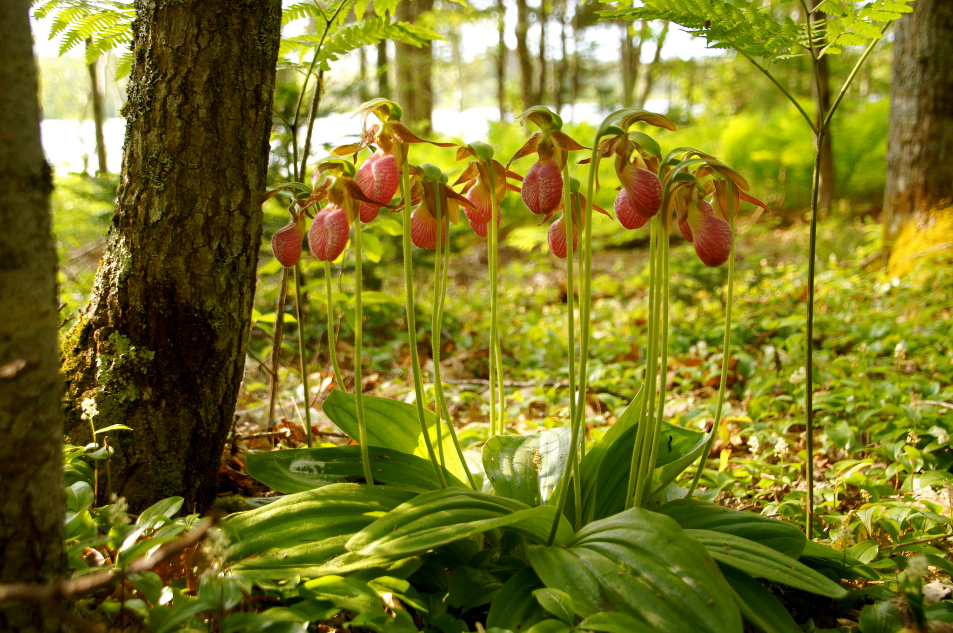
Fungi and Plants
Some fungi interact with plant roots.
They form a network of hyphae and roots known as mycorrhizae.
About 80% of all plants develop mycorrhizae.
The fungus helps the plant absorb more nutrients while the plant supplies food for the fungus.
Some plants like the Lady’s slipper orchid can’t grow with out the development of mycorrhizae.

Slide 10
Importance of Fungi
-Cultivated mushrooms are an important food crop; wild mushrooms should never be eaten because many are poisonous.
-The antibiotic Penicillin is produced by the fungi Penicillium.
-Fungi is important in foods and medicine but is most important as decomposers that break down organic materials.
- They keep the earth from becoming buried under mountains of organic waste material.

Slide 11
End of Chapter 8 Section 2

