Slide 1
Chapter 20 Notes

Slide 2
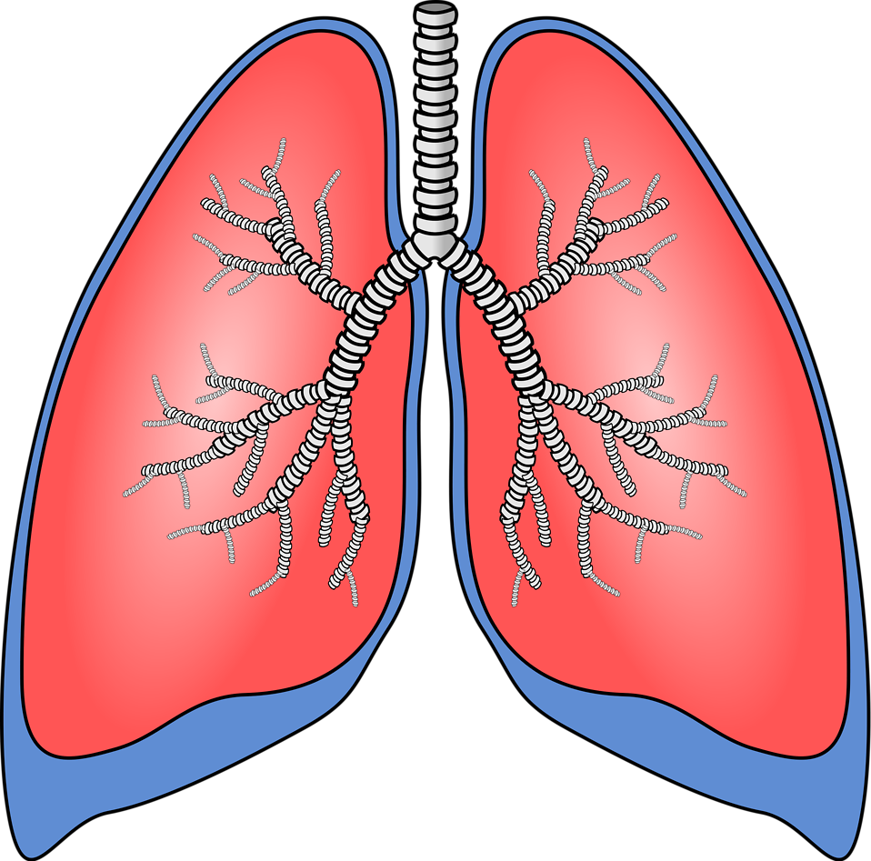
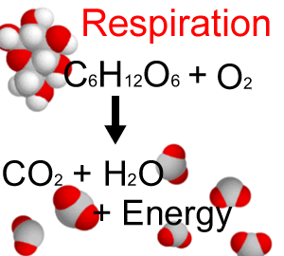
The Respiratory System
Breathing and respiration are not the same thing.
Breathing is the movement of the chest that brings air in and out of the lungs.
Respiration is the process where the oxygen is used to release energy from the glucose in the cells

Slide 3
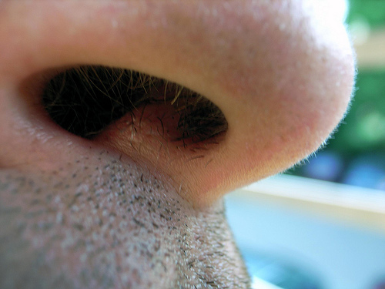
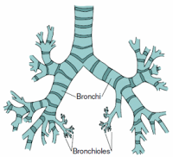
The Respiratory System
Fine hairs in the nostrils trap dust from the air, the air is moistened and warmed in the nasal cavity.
Mucus and cilia ( tiny, hair like structures) trap materials not trapped by nasal hairs.
Bronchioles are the smallest tubes that bronchi branch into that attach to alveoli.

Slide 4
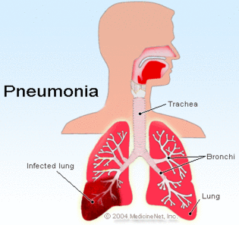
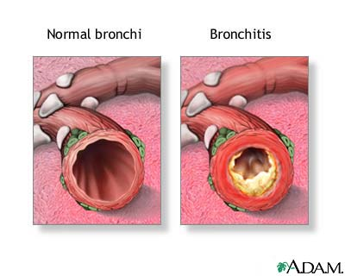
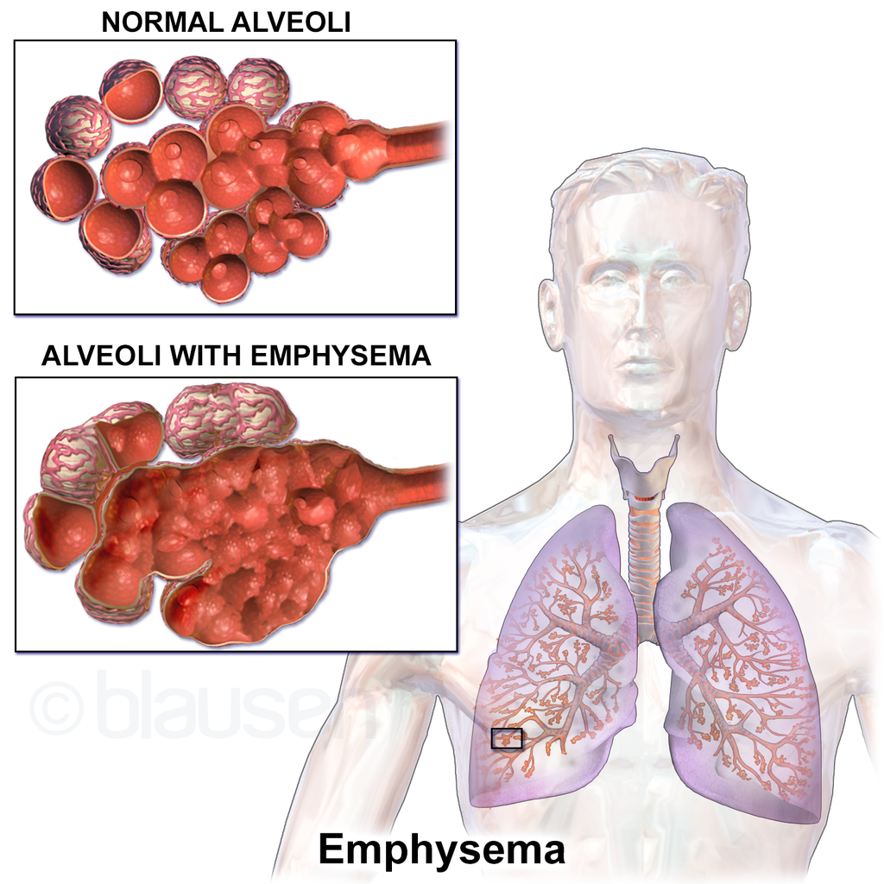
Respiratory Disorders
Pneumonia is an infection in the alveoli caused by bacteria, viruses, and other microorganisms.
Bronchitis is when the bronchial tubes are irritated and swell and too much mucus is produced.
Emphysema is when the alveoli enlarge, become reddened and swollen, causing the walls to break down so the alveoli can’t push the air out and not enough oxygen gets in the blood.
Emphysema causes a shortness of breath and often leads to heart problems.

Slide 5
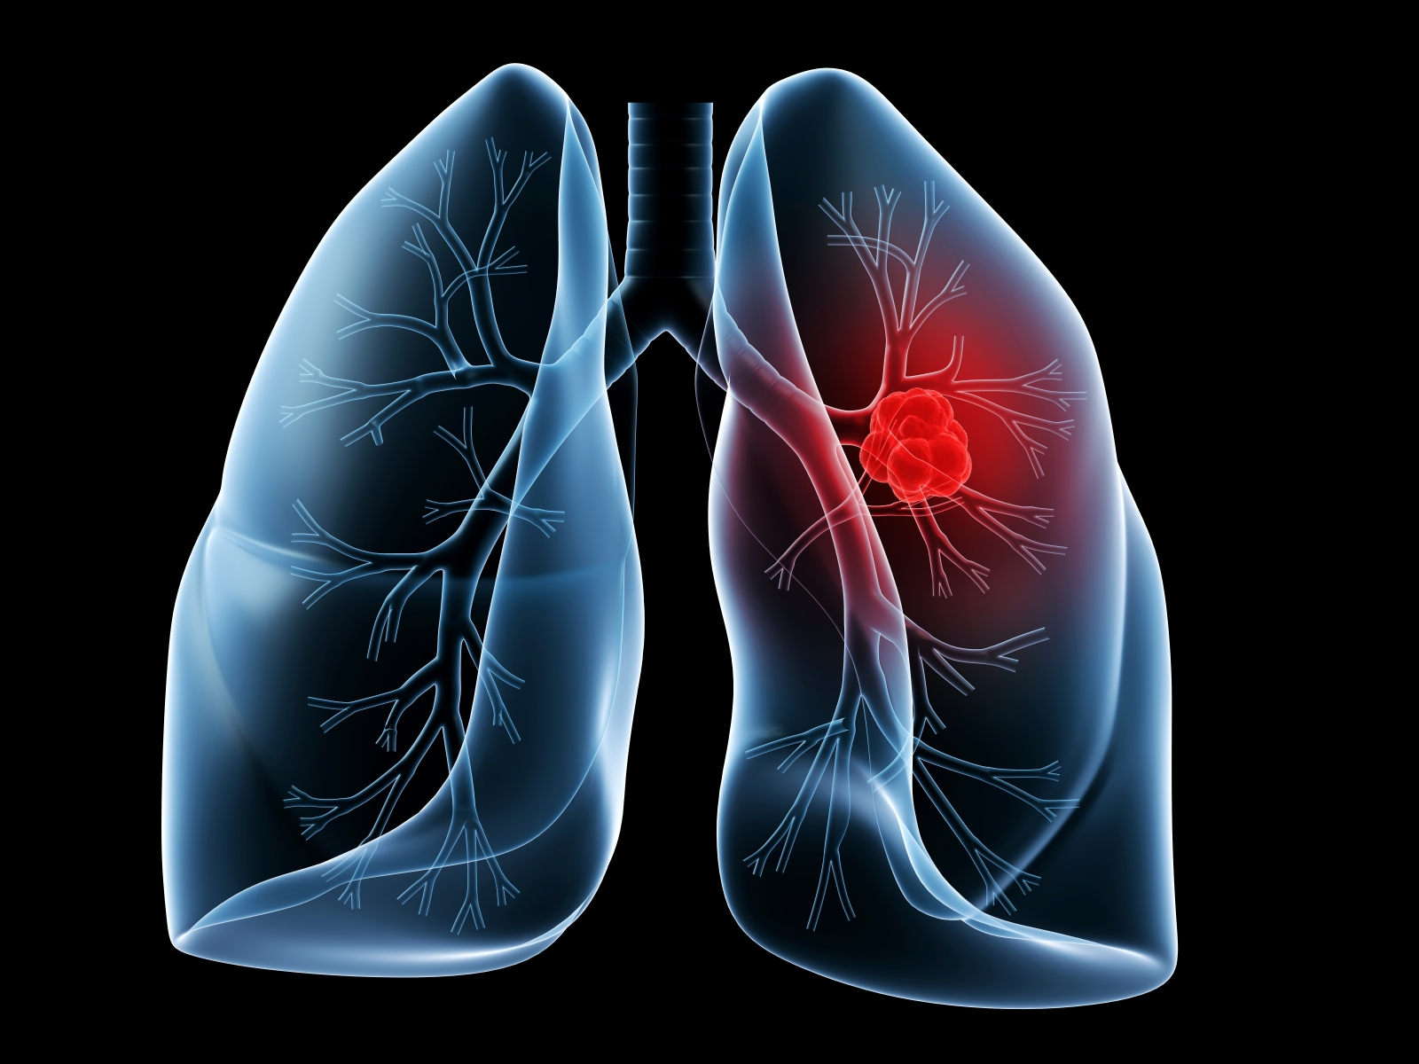
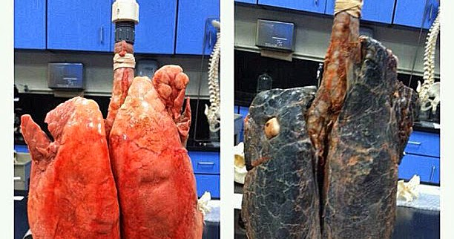
Respiratory Disorders
Lung Cancer is the third leading cause of death in the U.S. in men and women.
Carcinogens- substances ( example- cigarette smoke) that can cause and uncontrolled growth of cells (cancer).

Slide 6
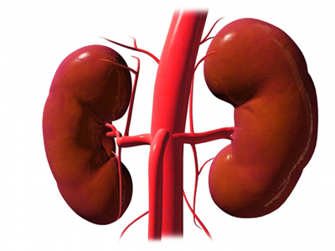
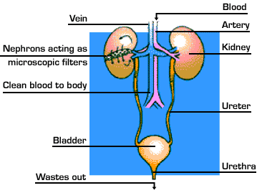
Section 2: The Excretory System
The Excretory system is responsible for the elimination of wastes produced by homeostasis.
Excretory organs is another name for the organs of the urinary system.
The liver also filters the blood to remove waste.

Slide 7
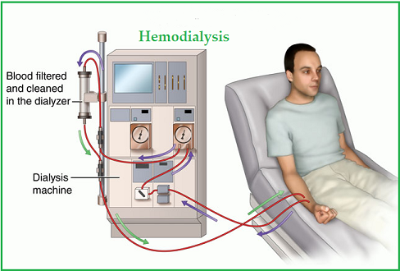
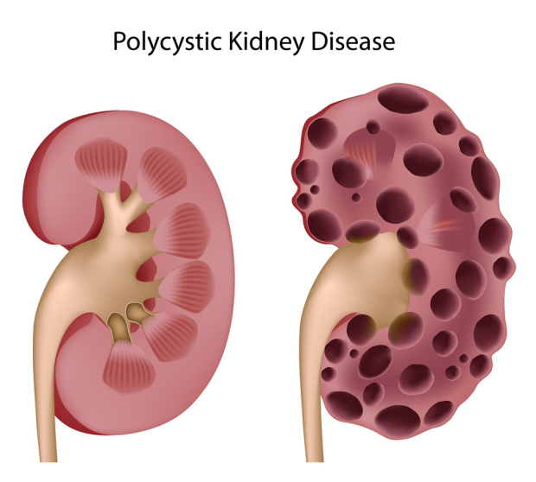
Excretory System Problems
A change in the urine’s color can suggest kidney or liver problems.
A person can live with only one kidney, it will increase in size to make up for the loss of the other kidney.
Dialysis is a artificial kidney machine that a person uses to filter the blood when they do not have a kidney or one that is not functioning correctly.
The liver can regenerate after either surgical removal or after chemical injury.
It is known that as little as 25% of the original liver mass can regenerate back to its full size.

