Slide 1
Chapter 4 Notes
Blood and the Circulatory System

Slide 2
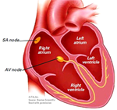
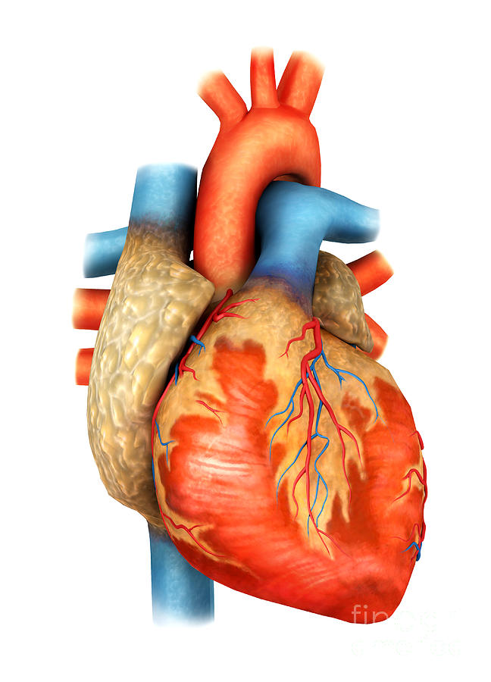
The Circulatory System
Your heart is made up of 4 chambers.
The left and right ventricle and the left and right atrium.
Veins carry blood to the heart and has a one way valve
Arteries carry blood away from the heart.

Slide 3
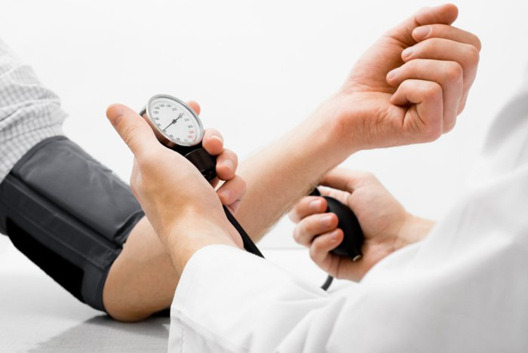
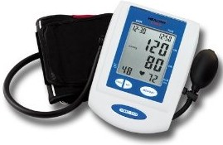
The Circulatory System
Blood pressure is the force of blood on the walls of blood vessels.
The normal resting pulse rates for adults is 60 to 100 beats per minute and for children its 80 to 100 beats a minute.
Blood pressure is expressed with two numbers such as 120 over 80.
The first number is when the heart contracts pushing the blood out and is called systolic.
The second number is when the heart fills back up with blood and is called the diastolic.

Slide 4
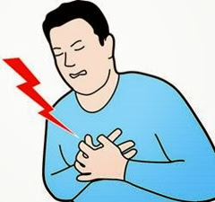
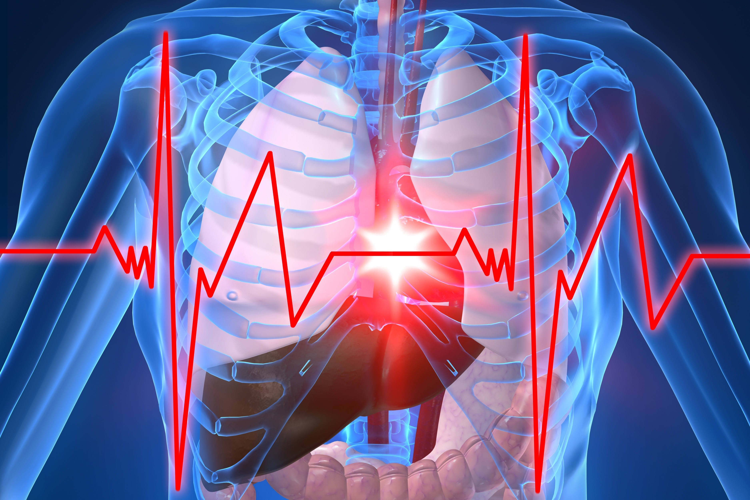
Heart Problems
Heart disease is the leading cause of death in the United States.
Atherosclerosis happens when fatty deposits build up on arterial walls.
Heart attacks can occur if the arteries to the heart become blocked.
Hypertension- (high blood pressure) when blood pressure is higher than normal. It can be caused by atherosclerosis.

Slide 5
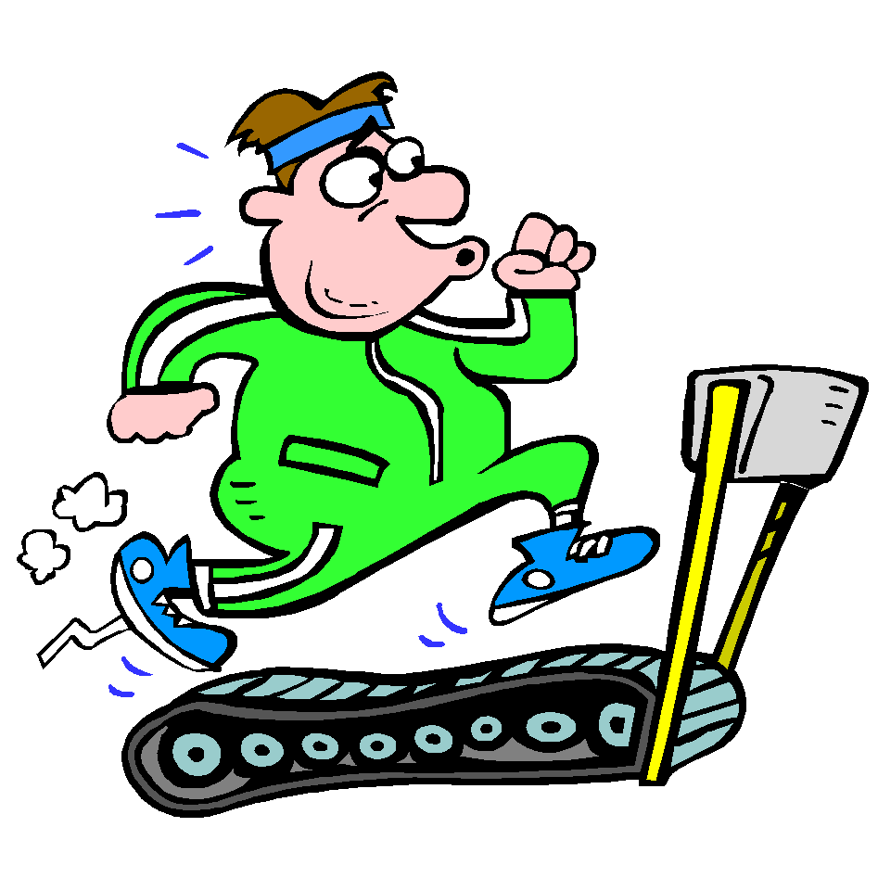
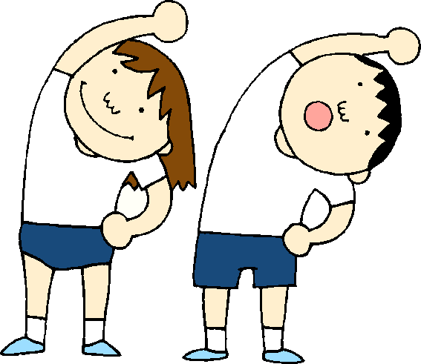
Heart Conditions
Heart failure results when the heart cannot pump blood efficiently.
This can cause fluid to collect in the arms, legs, and lungs.
Some ways to help prevent cardiovascular disease is a good diet, not smoking, learning to relax, controlling your weight, and having a regular exercise program.

Slide 6
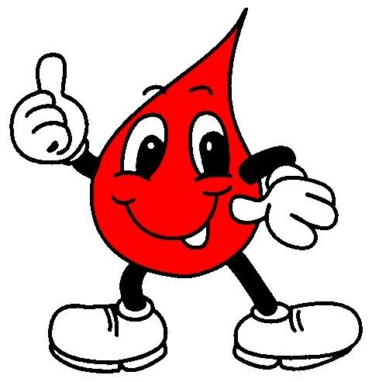
Section 2: Blood
There are 4 functions of the blood.
To carry oxygen to your body cells and bring back carbon dioxide.
To carry waste from cells to kidneys.
To transport nutrients and other substances to body cells.
To fight infections and help heal wounds.
Blood makes up about 8 percent of your body’s total mass.
An adult has about 5 liters of blood in their body.

Slide 7
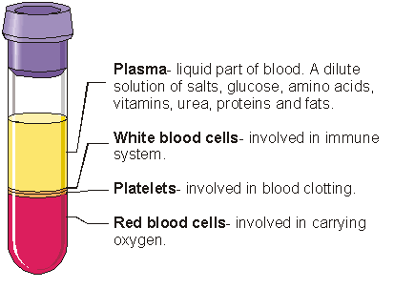
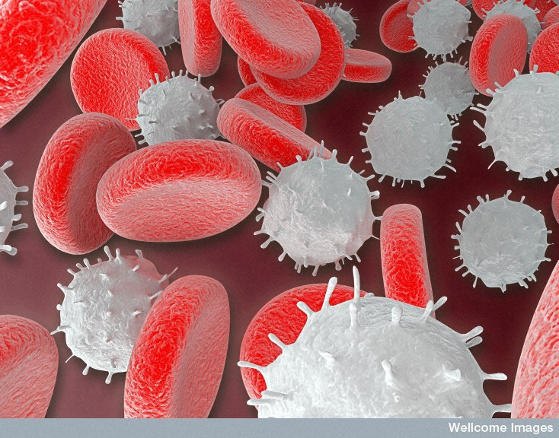
Blood
Plasma is the liquid part of the blood where nutrients, minerals, and oxygen are all dissolve into it.
White blood cells fight bacteria, viruses, and other invaders of your body.
The platelets in blood release chemicals that form threadlike fibers called fibrin that form a sticky net which causes the blood to clot.

Slide 8
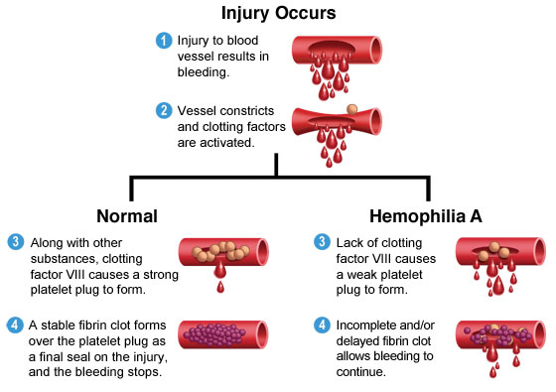
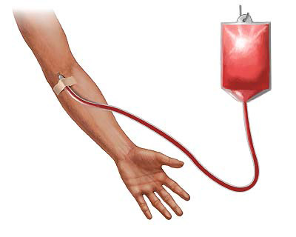
Blood
Hemophilia- genetic condition where plasma lacks one of the clotting factors.
During a blood transfusion, a person receives donated blood or parts of blood.
If the wrong type of blood is given the red blood cells will clump together forming clots and the person could die.

Slide 9
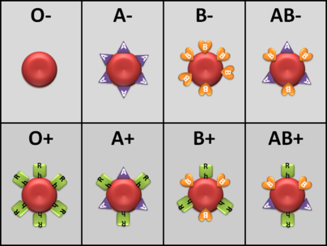
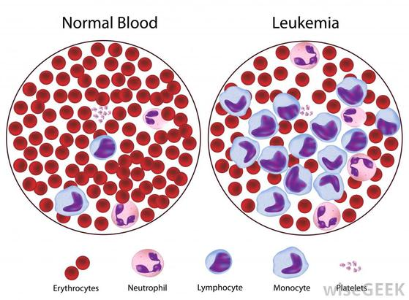
Blood Types and Conditions
The four types of blood are A, B, AB, and O.
Each type has specific antibodies that destroy substances that do not belong.
Because of the antibodies certain types of blood cannot be mixed.
Anemia- body tissues can’t get enough oxygen and are unable to carry on activities ( too few red blood cells).
Leukemia- too many white blood cells are made so they are immature and ineffective.

Slide 10
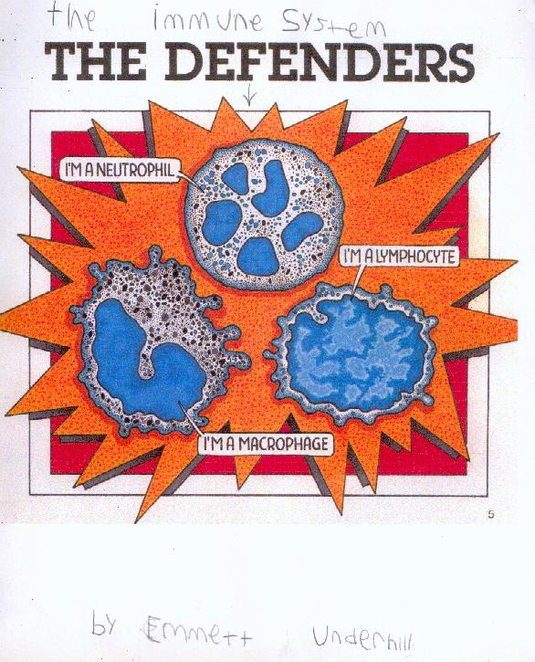
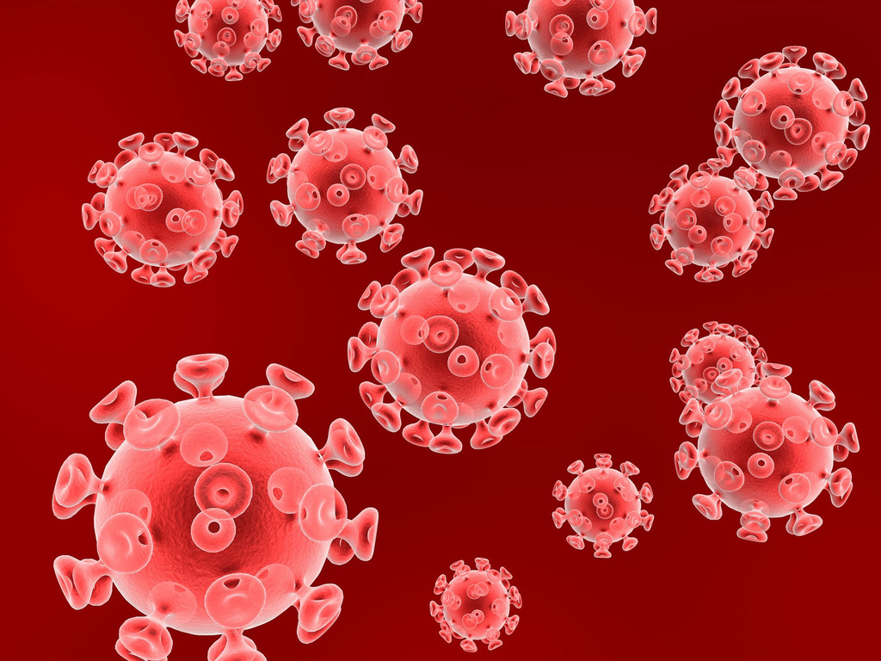
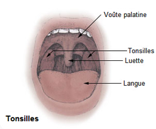
The Lymphatic System
Just like excess water runs down a drain, your body’s excess tissue fluid is removed by the lymphatic system.
The lymph drains into large veins near the heart.
Tonsils protect you from harmful microorganisms that enter through the mouth.
The spleen filters the blood by removing worn out and damaged red blood cells.
HIV attacks and destroys lymphocytes called helper T cells that help make antibodies to fight infection.

